Slide 1

Charcrete LCA
in Brightway
Group U1
Mija Frossard, Rahul Nallithodi, Charlotte Roux, Megan Roux, Lisa Zakrisson

Slide 2
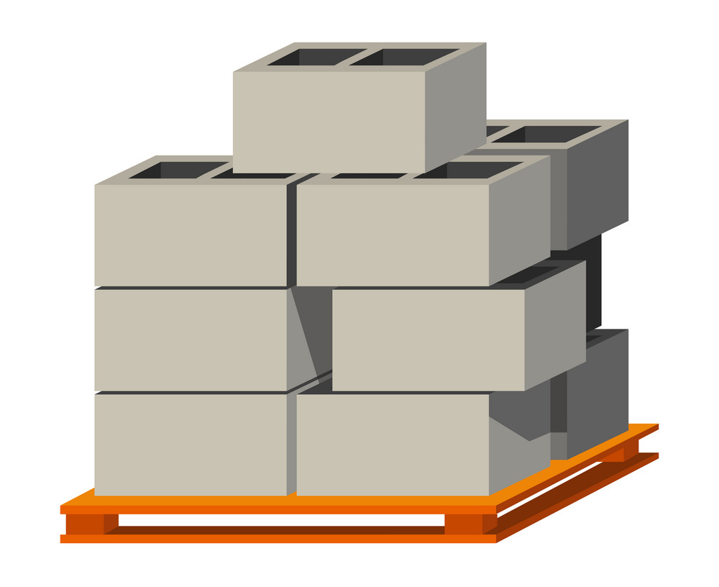
Presentation Structure
Background to the project
LCA methodology and system definition
Activities in Brightway
Results
Learnings and feedback

Slide 3
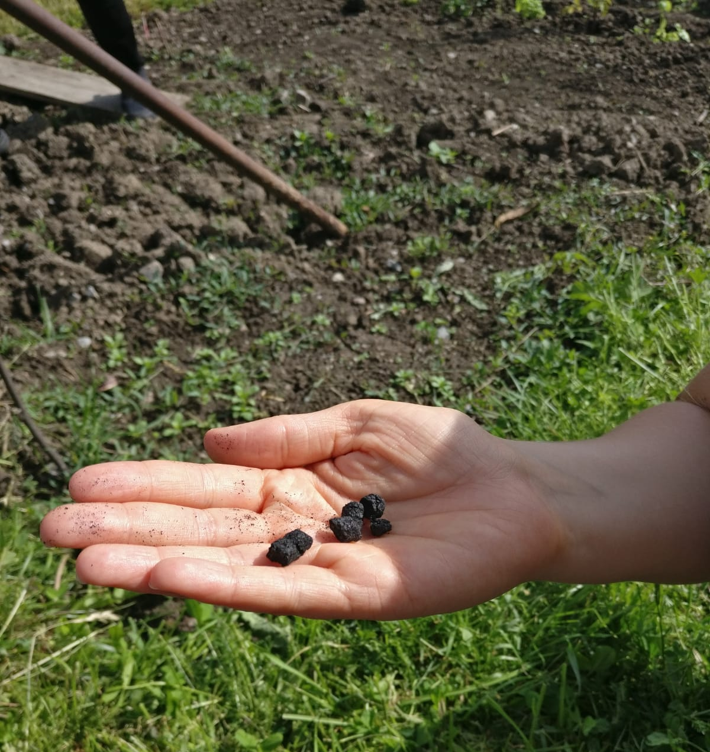
Project background
Biochar as a carbon sink
Biochar mixed into concrete = charcrete
Possible impact reduction in buildings
Project background
Notes:
How much reduction in CO2 emissions can be achieved with Charcrete?

Slide 4
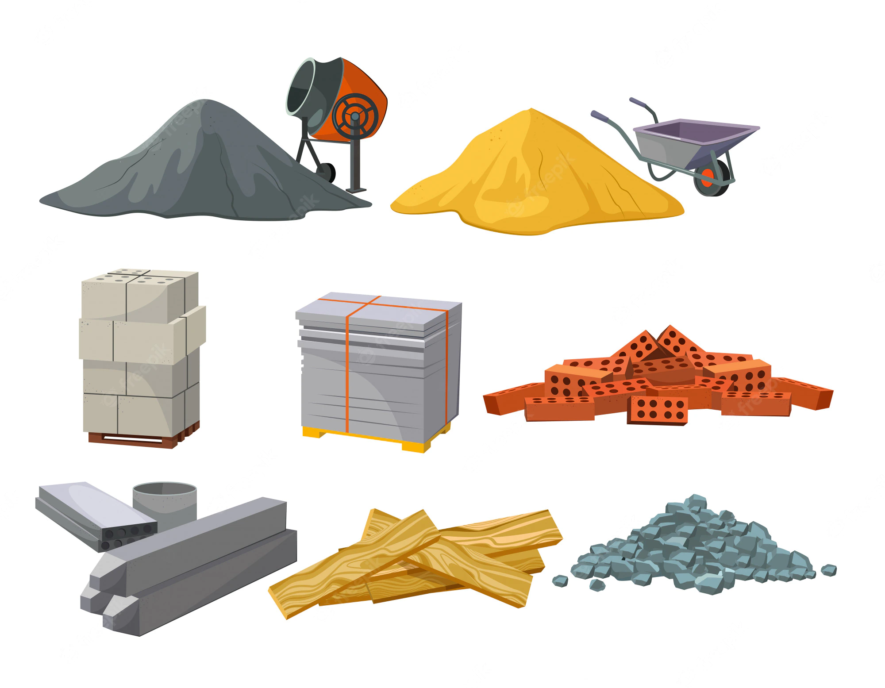



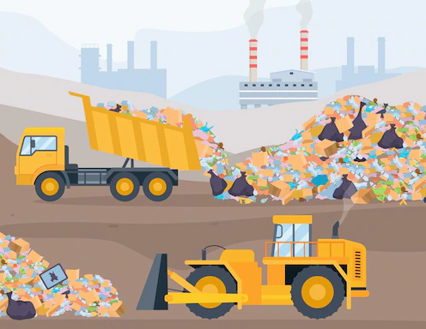
Charcrete Production Process
cement
sand, gravel and water
Cement production
wood
chips
biochar
charcrete
Generation of biomass residues
Charcrete production
Use in buildings
Pyrolysis
End-of-life
(Landfilling)
Project background

Slide 5
Scoping and System Definition
Goal: investigating the effects of replacing some conventional concrete with charcrete
Functional unit: production of 1 cubic metre of Charcrete
Impact categories: climate change
Impact assessment method: IPCC 2013 GWP₁₀₀
Three scenarios: 5%, 7.5% and 10% biochar in concrete
Comparison with conventional concrete production
LCA Methodology

Slide 6
Activities in Brightway (what we did)
Data collection and import into Brightway as new database
Scenarios generation through datapackages
Contribution analysis
Replacing cement type in charcrete
Concrete market modification with charcrete
Uncertainty analysis (background/foreground)
Correlated samples on CO2 sequestration
Activities in Brightway

Slide 7
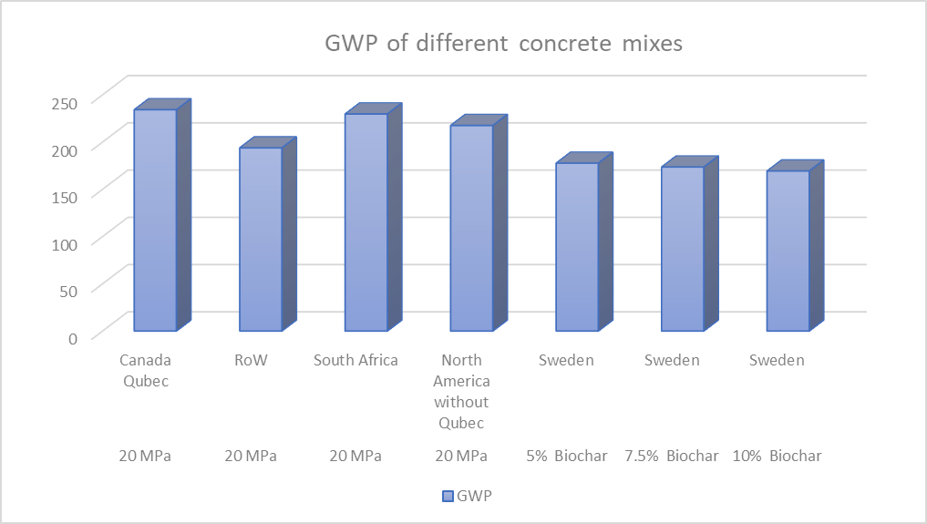
First Results
Results

Slide 8
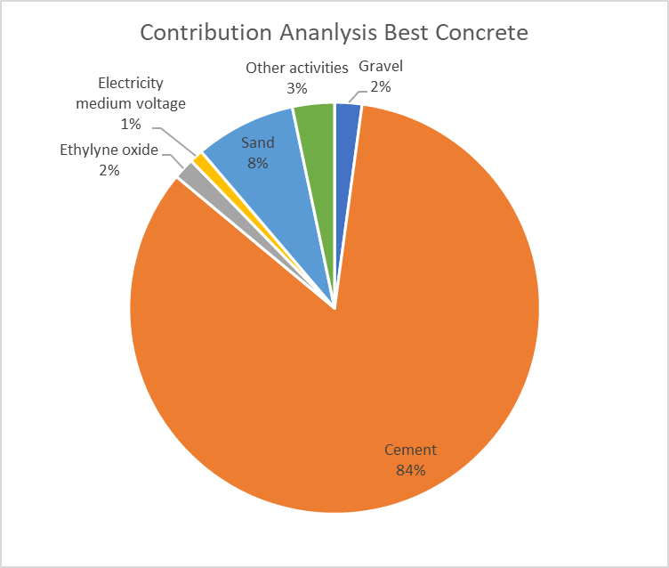
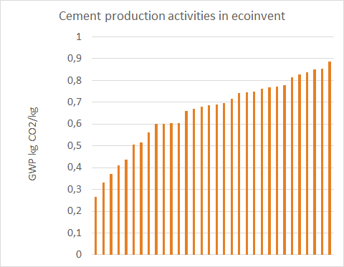
Contribution Analysis
Cement = 85-95 % contribution + large discrepancy
Results

Slide 9
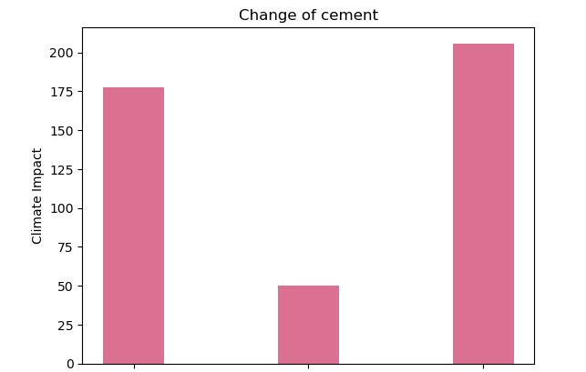
Changing Cement in Charcrete
A: Base case (market for cement, Portland, EU w/ CH)
B: Best (market for cement, blast furnace slag 81-95%, CH)
C: Worst (market for cement, Portland, ZA)
A
B
C
Results

Slide 10
Modifying Markets
A: Charcrete replaces an activity entirely:
B: Charcrete replaces several activities partially:
Market for concrete A
Market for concrete A
Market for concrete A
Market for concrete A
-10% of each market activity
+10% charcrete activity
Market for concrete B
Market for concrete B
Market for charcrete
Market for concrete B
Market for concrete C
Market for concrete C
Market for concrete C
Market for concrete C
Market for concrete D
Market for charcrete
Market for concrete D
Market for concrete D
Market for concrete D
Results
Notes:
Two different ideas
What we did with Chris - give example - what if Russia doesn’t deliver natural gas anymore, and we have to replace it with old local, coal power stations
Give example - what if we introduce a new technology, which will substitute shares of the other techs

Slide 11
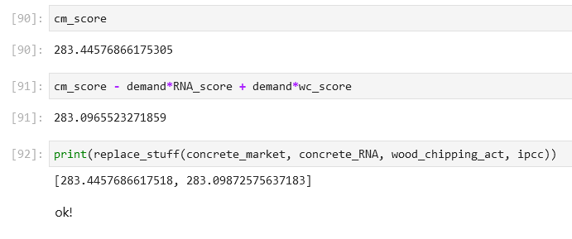
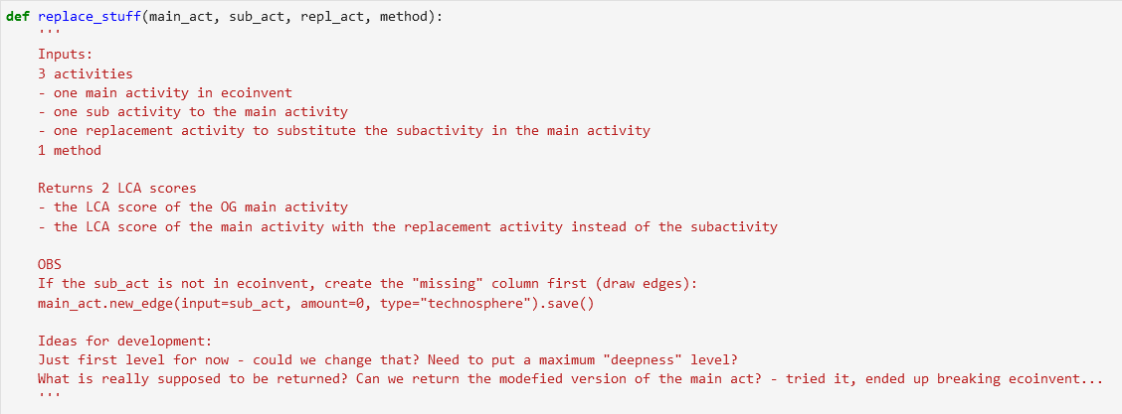
Generic function
Results
Notes:
Whenever you start copypasting - make it into a function
Made a function that substitutes any sub activity in a main activity, with a chosen replacement activity, and calculates the two lca scores using the given method
Verified that it works - Not exactly the same since I don’t have all the decimals in the “demand” variable

Slide 12
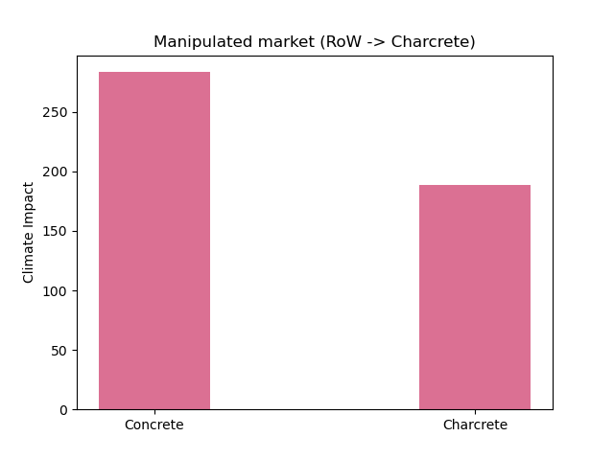
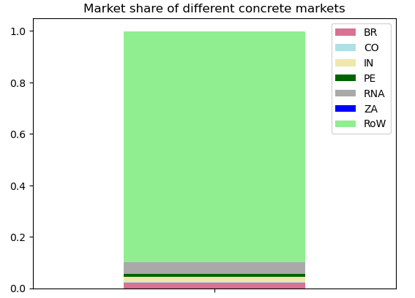
Modify market by substitution
Substitute RoW (89.5% of Normal concrete market) with charcrete
Results
Notes:
Market for “normal” concrete - the global market group
Shares of global market - replace a lot -> significant results
This example doesnt really make any real world-sense, I don’t see this happening, but you get the concept

Slide 13
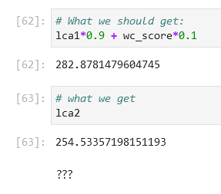

Modify market by shares
Market for concrete A
Market for concrete A
-10% of each market activity
+10% charcrete activity
Market for concrete B
Market for concrete B
Market for concrete C
Market for concrete C
Market for concrete D
Market for charcrete
Market for concrete D
Results
Notes:
And then the other concept - introduce a new technology on the market and
Good news: I have a function, and it doesn’t raise any errors when running it
Bad news: The results do not make sense, and I don’t know why

Slide 14

Uncertainties
CO₂ to soil = 325.6*biochar
Biochar amount (ton)
Uncertainty type: 2
Loc: 1.59
Scale: 0.1
Uncertainty type : 2
Loc: -4.20
Scale: 0.1
Plasticizer = 33 % biochar
Cement = 200 - biochar - plasticizer
Results

Slide 15
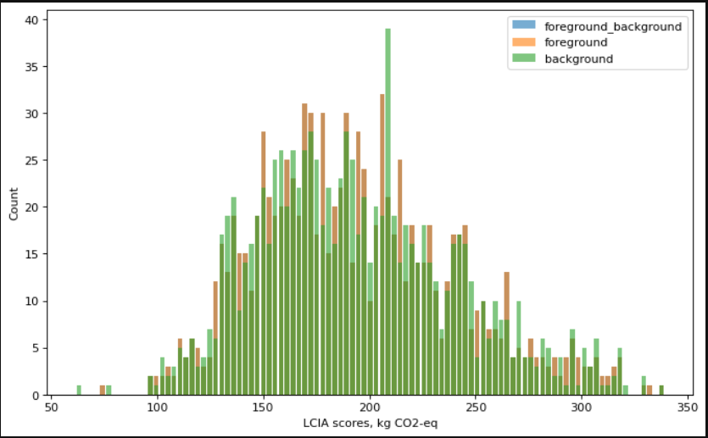
Uncertainty Analysis
no sensitivity analysis…
Results

Slide 16
Correlated samples
Link between biochar amount in charcrete and carbon sequestration amount through a simple ratio to run uncertainty analysis
We manage to go all the way through (thanks to Sasha) BUT
our method didn’t have a characterization factor for our flow so we cannot see the difference
(but we are pretty confident that it works ;) )
Results

Slide 17


Learnings
“Should I pull or should I go”
Setting up a good working space with JupyterLab and GitHub
Becoming more confident in Brightway (2.5)
Importing Excel files to Brightway
Creating data packages
*
Learnings

Slide 18
What we loved about this week:
The food, location and organisation of the course
Good sense of community and a good vibe
Tutors have been super helpful and accessible
Format of content: lectures followed by exercise
Exposure to high level of Brightway
What we would have changed:
The pace was a bit fast: difficult to complete exercises in the time given
An introduction to git/setting up shared workspace would be nice
Project tasks for different levels so that group members with varying skills can all contribute
Feedback

Slide 19


Thank you

